Slide 1
Proofs

Slide 2
Direct Proofs
Proving p → q(implications)
Step 1: Assume p (is true)
Step 2: Show that q logically follows

Slide 3
Direct Proofs: Example 1
If n is odd then 3n + 2 is odd

Slide 4
Direct Proofs: Example 1
If n is odd then 3n + 2 is odd
p: n is odd q: 3n + 2 is odd

Slide 5
Direct Proofs: Example 1
If n is odd then 3n + 2 is odd
p: n is odd q: 3n + 2 is odd
Step1: Assume, p is true.
Hence, n is odd

Slide 6
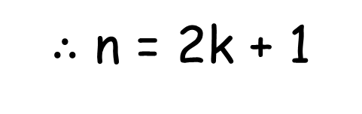
Direct Proofs: Example 1
If n is odd then 3n + 2 is odd
p: n is odd q: 3n + 2 is odd
Step1: Assume, p is true.
Hence, n is odd
$∴$ n = 2k + 1

Slide 7
Direct Proofs: Example 1
Step2:
3n + 2
= 3 * (2k + 1) + 2
= 6k + 5
= 6k + 4 + 1
= 2 (3k + 2) + 1
= 2 m+ 1

Slide 8

Direct Proofs: Example 1
Step2:
3n + 2
= 3 * (2k + 1) + 2
= 6k + 5
= 6k + 4 + 1
= 2 (3k + 2) + 1
= 2 m+ 1
$∴$ 3n + 2 is odd

Slide 9
Direct Proofs: Example 2
If 0 $≤$ x $≤$2, then prove that ${−x}^{3}+4x+1>0$

Slide 10
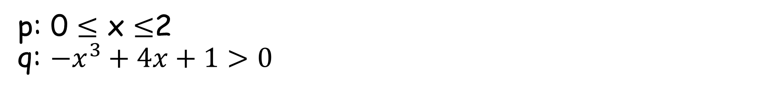
Direct Proofs: Example 2
If 0 $≤$ x $≤$2, then prove that ${−x}^{3}+4x+1>0$
p: 0 $≤$ x $≤$2 q: ${−x}^{3}+4x+1>0$

Slide 11

Direct Proofs: Example 2
If 0 $≤$ x $≤$2, then prove that ${−x}^{3}+4x+1>0$
p: 0 $≤$ x $≤$2 q: ${−x}^{3}+4x+1>0$
Step1: Assume, p is true.
Hence, 0 $≤$ x $≤$2 is true

Slide 12

Direct Proofs: Example 2
Step2:
$${−x}^{3}+4x+1 \\ =x\left({−x}^{2}+4\right)+1 \\ =x\left(2+x\right)\left(2−x\right)+1$$

Slide 13
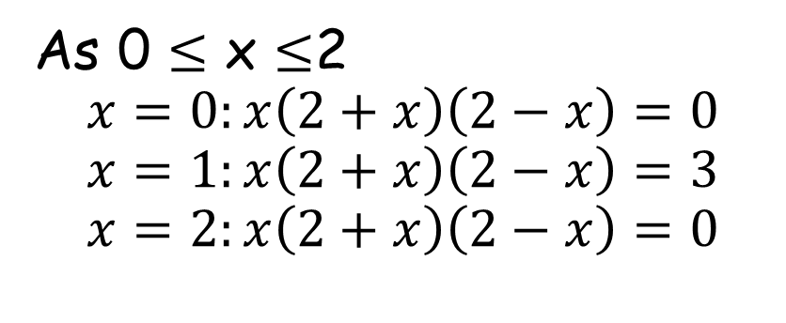
Direct Proofs: Example 2
Step2:
$${−x}^{3}+4x+1 \\ =x\left({−x}^{2}+4\right)+1 \\ =x\left(2+x\right)\left(2−x\right)+1$$
As 0 $≤$ x $≤$2
$$x=0:x\left(2+x\right)\left(2−x\right)=0 \\ x=1:x\left(2+x\right)\left(2−x\right)=3 \\ x=2:x\left(2+x\right)\left(2−x\right)=0$$

Slide 14

Direct Proofs: Example 2
Step2:
$${−x}^{3}+4x+1 \\ =x\left({−x}^{2}+4\right)+1 \\ =x\left(2+x\right)\left(2−x\right)+1$$
As 0 $≤$ x $≤$2
$$x=0:x\left(2+x\right)\left(2−x\right)=0 \\ x=1:x\left(2+x\right)\left(2−x\right)=3 \\ x=2:x\left(2+x\right)\left(2−x\right)=0$$
$$∴x\left(2+x\right)\left(2−x\right)+1>0 \\ ∴{−x}^{3}+4x+1>0$$

Slide 15
Proof by Contraposition
p → q(implications)
Contrapositive: ￢q → ￢p
p → q ≡ ￢q → ￢p
Proving one is as good as proving the other proving the contrapositive is some-times easier than proving the implication

Slide 16
Proof by Contraposition
Contrapositive: ￢q → ￢p
Step 1: Assume ￢q (is true)
Step 2: Show that ￢p logically follows

Slide 17
Proof by Contraposition: Example 1
If 3n + 2 is odd then n is odd

Slide 18
Proof by Contraposition: Example 1
If 3n + 2 is odd then n is odd
p: 3n + 2 is odd q: n is odd

Slide 19
Proof by Contraposition: Example 1
If 3n + 2 is odd then n is odd
p: 3n + 2 is odd q: n is odd
￢ p: 3n + 2 is even ￢ q: n is even

Slide 20
Proof by Contraposition: Example 1
If 3n + 2 is odd then n is odd
p: 3n + 2 is odd q: n is odd
￢ p: 3n + 2 is even ￢ q: n is even
Step1: Assume, ￢ q is true.
Hence, n is even

Slide 21

Proof by Contraposition: Example 1
If 3n + 2 is odd then n is odd
p: 3n + 2 is odd q: n is odd
￢ p: 3n + 2 is even ￢ q: n is even
Step1: Assume, ￢ q is true.
Hence, n is even
$∴$ n = 2k

Slide 22
Proof by Contraposition: Example 1
Step2:
3n + 2
= 3 * (2k) + 2
= 6k + 2
= 2 (3k + 1)
= 2 m

Slide 23

Proof by Contraposition: Example 1
Step2:
3n + 2
= 3 * (2k) + 2
= 6k + 2
= 2 (3k + 1)
= 2 m
$∴$ 3n + 2 is even

Slide 24

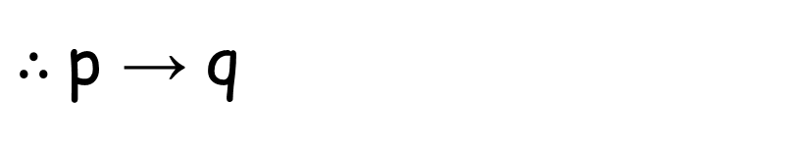
Proof by Contraposition: Example 1
Step2:
3n + 2
= 3 * (2k) + 2
= 6k + 2
= 2 (3k + 1)
= 2 m
$∴$ 3n + 2 is even
$∴$ ￢q → ￢p
$∴$p → q

Slide 25
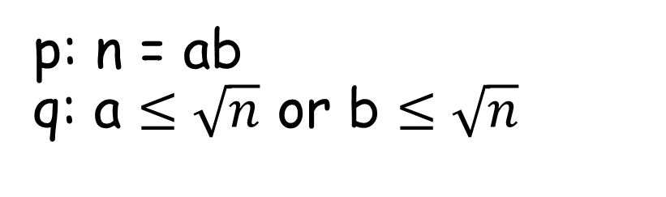
Proof by Contraposition: Example 2
If n = ab then a $≤\sqrt{n}$ or b $≤\sqrt{n}$
p: n = ab q: a $≤\sqrt{n}$ or b $≤\sqrt{n}$

Slide 26
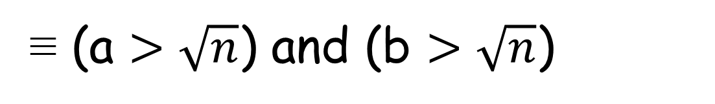
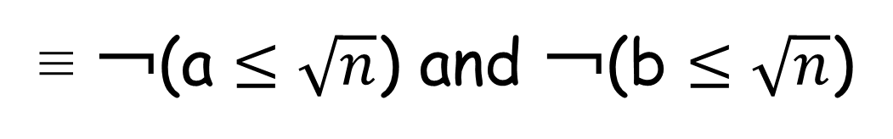
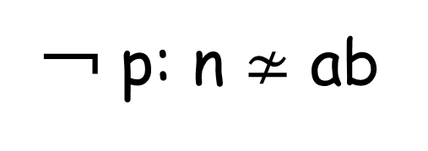

Proof by Contraposition: Example 2
If n = ab then a $≤\sqrt{n}$ or b $≤\sqrt{n}$
p: n = ab q: a $≤\sqrt{n}$ or b $≤\sqrt{n}$
￢ q: ￢(a $≤\sqrt{n}$ or b $≤\sqrt{n}$)
≡ ￢(a $≤\sqrt{n}$) and ￢(b $≤\sqrt{n}$)
￢ p: n $≄$ ab
≡ (a $>\sqrt{n}$) and (b $>\sqrt{n}$)

Slide 27
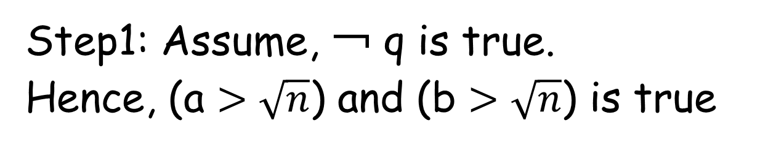
Proof by Contraposition: Example 2
Step1: Assume, ￢ q is true.
Hence, (a $>\sqrt{n}$) and (b $>\sqrt{n}$) is true

Slide 28
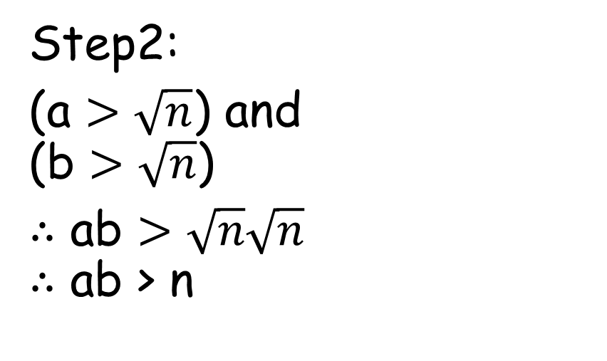
Proof by Contraposition: Example 2
Step1: Assume, ￢ q is true.
Hence, (a $>\sqrt{n}$) and (b $>\sqrt{n}$) is true
Step2:
(a $>\sqrt{n}$) and (b $>\sqrt{n}$)
$∴$ ab $>\sqrt{n}\sqrt{n}$ $∴$ ab > n

Slide 29
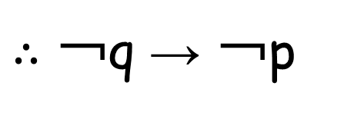
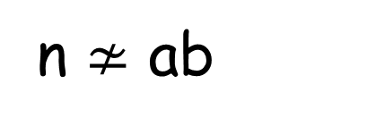
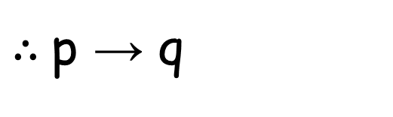
Proof by Contraposition: Example 2
Step1: Assume, ￢ q is true.
Hence, (a $>\sqrt{n}$) and (b $>\sqrt{n}$) is true
Step2:
(a $>\sqrt{n}$) and (b $>\sqrt{n}$)
$∴$ ab $>\sqrt{n}\sqrt{n}$ $∴$ ab > n
n $≄$ ab
$∴$ ￢q → ￢p
$∴$p → q

Slide 30
Proof by Contradiction
p → q(implications)
Step1: Assume, p is true.
Step2: Assume, ￢ q is true.
Step3: Prove that ￢p is true from ￢ q

Slide 31
Proof by Contradiction: Example 1
If 3n + 2 is odd then n is odd
p: 3n + 2 is odd q: n is odd
￢ p: 3n + 2 is even ￢ q: n is even

Slide 32
Proof by Contradiction: Example 1
If 3n + 2 is odd then n is odd
p: 3n + 2 is odd q: n is odd
￢ p: 3n + 2 is even ￢ q: n is even
Step1: Assume, p is true.
Hence, 3n + 2 is odd

Slide 33

Proof by Contradiction : Example 1
Step2: Assume, ￢ q is true.
Hence, n is even
$∴$ n = 2k

Slide 34
Proof by Contradiction : Example 1
Step2: Assume, ￢ q is true.
Hence, n is even
$∴$ n = 2k
Step3: Prove that ￢p is true
3n + 2
= 3 * (2k) + 2
= 6k + 2
= 2 (3k + 1)
= 2 m

Slide 35
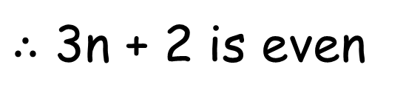

Proof by Contradiction : Example 1
Step2: Assume, ￢ q is true.
Hence, n is even
$∴$ n = 2k
Step3: Prove that ￢p is true
3n + 2
= 3 * (2k) + 2
= 6k + 2
= 2 (3k + 1)
= 2 m
$∴$ 3n + 2 is even
$∴$ ￢p is true

Slide 36
Proof by Contradiction: Example 1
From Step1: p is true.
Hence, 3n + 2 is odd

Slide 37
Proof by Contradiction: Example 1
From Step1: p is true.
Hence, 3n + 2 is odd
From Step3: ￢p is true
3n + 2 is even

Slide 38
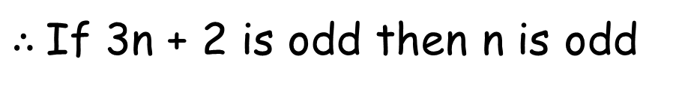
Proof by Contradiction: Example 1
From Step1: p is true.
Hence, 3n + 2 is odd
From Step3: ￢p is true
3n + 2 is even
This is a contradiction
$∴$If 3n + 2 is odd then n is odd

Slide 39
Proof by Contradiction
p (propositional statement)
Step1: Assume, ￢ p is true.

Slide 40
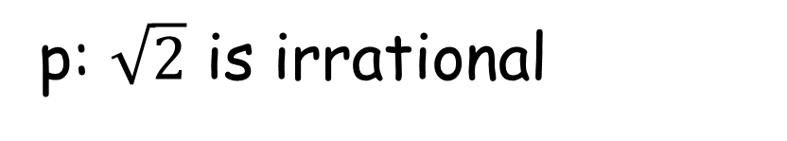
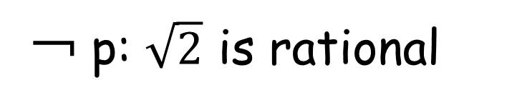

Proof by Contradiction: Example 2
Prove that $\sqrt{2}$ is irrational
p: $\sqrt{2}$ is irrational
￢ p: $\sqrt{2}$ is rational
Step1: Assume, ￢ p is true.
Hence, $\sqrt{2}$ is rational

Slide 41
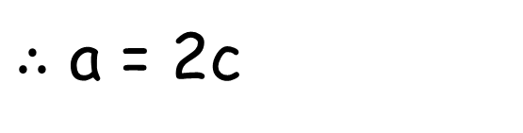
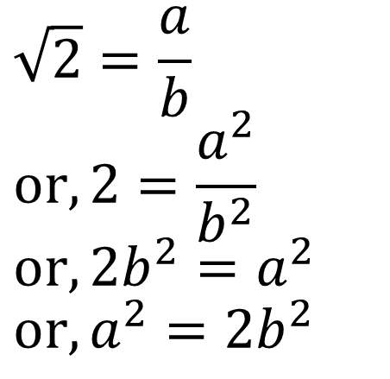
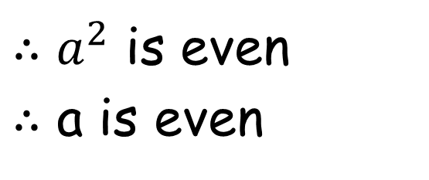
Proof by Contradiction: Example 2
$$\sqrt{2}=\frac{a}{b} \\ or, 2=\frac{a^{2}}{b^{2}} \\ or,2b^{2}=a^{2} \\ or,a^{2}=2b^{2}$$
$∴a^{2}$ is even
$∴$ a is even
$∴$ a = 2c

Slide 42


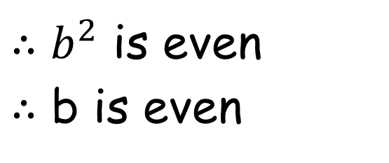
Proof by Contradiction: Example 2
$${(2c)}^{2}=2b^{2} \\ or, 4c^{2}=2b^{2} \\ or, 2c^{2}=b^{2} \\ or,b^{2}=2c^{2}$$
$∴b^{2}$ is even
$∴$ b is even
$∴$ b = 2d

Slide 43
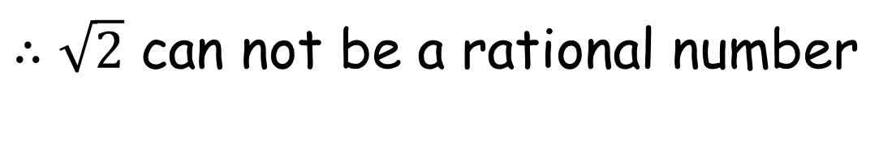
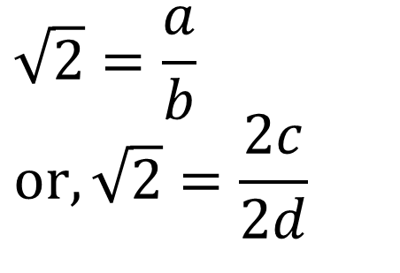
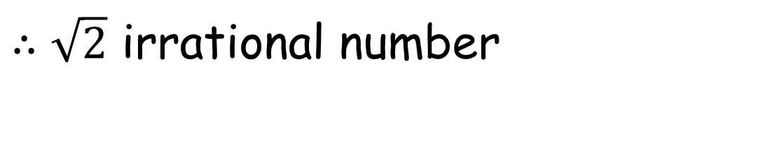
Proof by Contradiction: Example 2
$$\sqrt{2}=\frac{a}{b} \\ or,\sqrt{2}=\frac{2c}{2d}$$
$∴\sqrt{2}$ can not be a rational number
$∴\sqrt{2}$ irrational number

Slide 44
Proof by Induction
∀np(n), n is a positive integer
Step 1(Basis step): verify that p(1) is true.
Step 2(Inductive step): Show that
∀k p(k) → p(k+1) is true, k is a positive integer

Slide 45
Proof by Induction: Example 1
p(n)::=[1 + 2 + … + n = n(n+1) / 2]

Slide 46
Proof by Induction: Example 1
p(n)::=[1 + 2 + … + n = n(n+1) / 2]
Step 1(Basis step):
p(1)::=[1 = 1(1+1) / 2] = True

Slide 47
Proof by Induction: Example 1
Step 2(Inductive step):
Show that
∀k p(k) → p(k+1) is true, k is a positive integer
p(k): 1 + 2 + … + k = k(k + 1) / 2
p(k+1): 1 + 2 + … + (k+1) = (k+1)(k + 2) / 2

Slide 48
Proof by Induction: Example 1
Assume, p(k) is true
$∴$1 + 2 + … + k = k(k + 1) / 2

Slide 49
Proof by Induction: Example 1
Assume, p(k) is true
$∴$1 + 2 + … + k = k(k + 1) / 2
or, 1 + 2 + … + k + (k+1) = k(k + 1) / 2 + (k+1)
Why add (k+1)?
→ Check p(k+1)

Slide 50
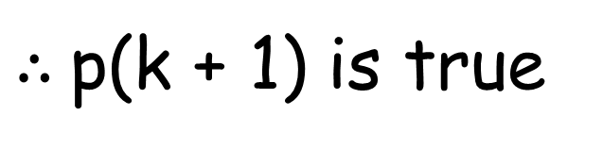
Proof by Induction: Example 1
Show that, p(k+1) is true
$∴$p(k + 1) is true
1 + 2 + … + k = k(k + 1) / 2
or, 1 + 2 + … + k + (k+1) = k(k + 1) / 2 + (k+1)
or, 1 + 2 + … … + (k+1) = k(k + 1) / 2 + (k+1)
or, 1 + 2 + … … + (k+1) = (k + 1) (k+2)/ 2

Slide 51
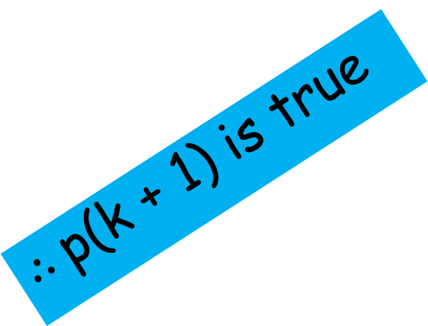
Proof by Induction: Example 1
$∴$p(k + 1) is true
Show that, p(k+1) is true
∀k p(k) → p(k+1)
1 + 2 + … + k = k(k + 1) / 2
or, 1 + 2 + … + k + (k+1) = k(k + 1) / 2 + (k+1)
or, 1 + 2 + … … + (k+1) = k(k + 1) / 2 + (k+1)
or, 1 + 2 + … … + (k+1) = (k + 1) (k+2)/ 2

Slide 52
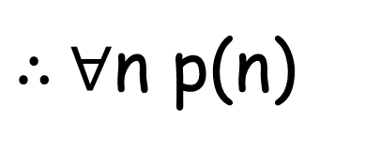
Proof by Induction: Example 1
p(1) and ∀k p(k) → p(k+1)
$∴$∀n p(n)

Slide 53
Proof by Induction: Example 2
p(n)::=[2^{n} < n!] for n>= 4
Step 1(Basis step):
p(4)::=[16 < 24] = True

Slide 54
Proof by Induction: Example 2
Step 2(Inductive step):
Show that
p(k) → p(k+1) is true, k >=4
p(k): 2^{k} < k!
p(k+1): 2^{k+1} < (k+1)!

Slide 55

Proof by Induction: Example 2
Assume, p(k) is true
$∴$2^{k} < k!
or, 2^{k} 2< k! 2
or, 2^{k+1} < 2 k!
or, 2^{k+1} < (k+1) k! [k > = 4]
or, 2^{k+1} < (k+1)!

Slide 56

Proof by Induction: Example 2
Assume, p(k) is true
$∴$p(k + 1) is true
$∴$2^{k} < k!
or, 2^{k} 2< k! 2
or, 2^{k+1} < 2 k!
or, 2^{k+1} < (k+1) k! [k > = 4]
or, 2^{k+1} < (k+1)!

